Slide 1

Sorting Algorithms
Subject: Soft Computing
Teacher: Leyla Muradkhanli
By Ravan Mammadov & Fidan Mammadova

Slide 2
Types of Sorting Algorithms
Buble Sort
Selection Sort
Insertion Sort
Merge Sort
Quick Sort

Slide 3
Types of Sorting Algorithms
Buble Sort
Selection Sort
Insertion Sort
Merge Sort
Quick Sort

Slide 4
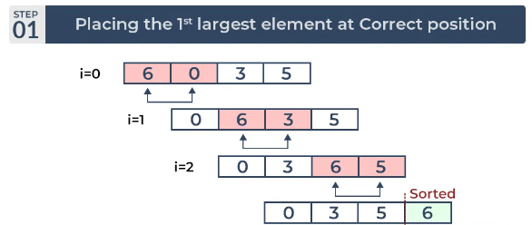
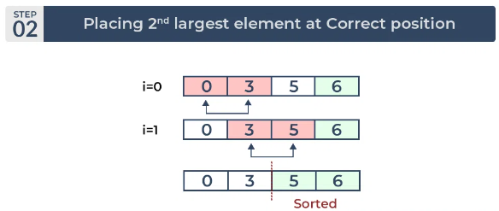
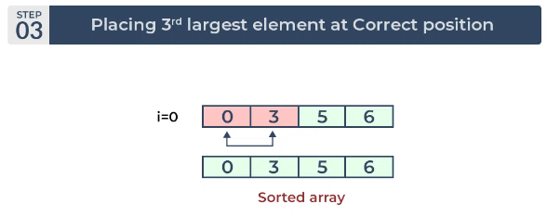
Types of Sorting Algorithms
Buble Sort
Advantages of Bubble Sort:
Bubble sort is easy to understand and implement.
It does not require any additional memory space.
It is a stable sorting algorithm, meaning that elements with the same key value maintain their relative order in the sorted output.
Disadvantages of Bubble Sort:
Bubble sort has a time complexity of O(N²) which makes it very slow for large data sets.
Bubble sort is a comparison-based sorting algorithm, which means that it requires a comparison operator to determine the relative order of elements in the input data set. It can limit the efficiency of the algorithm in certain cases.
Selection Sort
Insertion Sort
Merge Sort
Quick Sort

Slide 5
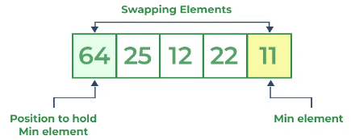
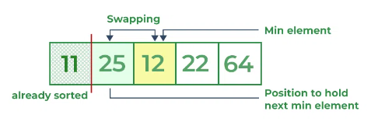
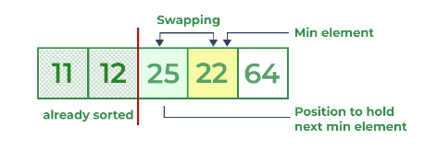
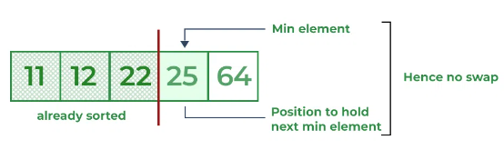
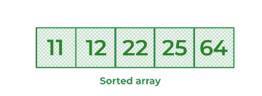
Types of Sorting Algorithms
Buble Sort
Selection Sort
Advantages of Selection Sort Algorithm
Simple and easy to understand.
Works well with small datasets.
Disadvantages of the Selection Sort Algorithm
Selection sort has a time complexity of O(n^2) in the worst and average case.
Does not work well on large datasets.
Does not preserve the relative order of items with equal keys which means it is not stable.
Insertion Sort
Merge Sort
Quick Sort
Advantages of Bubble Sort:
Bubble sort is easy to understand and implement.
It does not require any additional memory space.
It is a stable sorting algorithm, meaning that elements with the same key value maintain their relative order in the sorted output.
Disadvantages of Bubble Sort:
Bubble sort has a time complexity of O(N²) which makes it very slow for large data sets.
Bubble sort is a comparison-based sorting algorithm, which means that it requires a comparison operator to determine the relative order of elements in the input data set. It can limit the efficiency of the algorithm in certain cases.

Slide 6
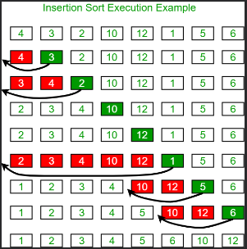
Selection Sort
Insertion Sort
Advantages of Insertion Sort Algorithm
It, like other quadratic sorting algorithms, is efficient for small data sets.
It just necessitates a constant amount of O(1) extra memory space.
It works well with data sets that have been sorted in a significant way.
It does not affect the relative order of elements with the same key.
Disadvantages of the Insertion Sort Algorithm
Insertion sort is inefficient against more extensive data sets
The insertion sort exhibits the worst-case time complexity of O(n2)
It does not perform well than other, more advanced sorting algorithms
Advantages of Selection Sort Algorithm
Simple and easy to understand.
Works well with small datasets.
Disadvantages of the Selection Sort Algorithm
Selection sort has a time complexity of O(n^2) in the worst and average case.
Does not work well on large datasets.
Does not preserve the relative order of items with equal keys which means it is not stable.
Merge Sort
Quick Sort

Slide 7
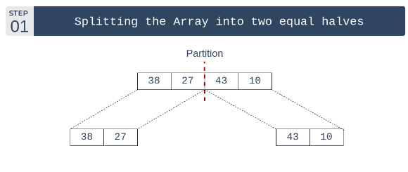
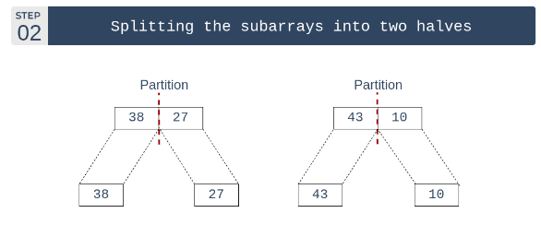
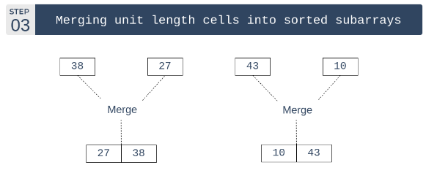

Insertion Sort
Merge Sort
Advantages of Merge Sort:
Stability: Merge sort is a stable sorting algorithm, which means it maintains the relative order of equal elements in the input array.
Guaranteed worst-case performance: Merge sort has a worst-case time complexity of O(N logN), which means it performs well even on large datasets.
Parallelizable: Merge sort is a naturally parallelizable algorithm, which means it can be easily parallelized to take advantage of multiple processors or threads.
Disadvantages of Merge Sort:
Space complexity: Merge sort requires additional memory to store the merged sub-arrays during the sorting process.
Not in-place: Merge sort is not an in-place sorting algorithm, which means it requires additional memory to store the sorted data. This can be a disadvantage in applications where memory usage is a concern.
Not always optimal for small datasets: For small datasets, Merge sort has a higher time complexity than some other sorting algorithms, such as insertion sort. This can result in slower performance for very small datasets.
Advantages of Insertion Sort Algorithm
It, like other quadratic sorting algorithms, is efficient for small data sets.
It just necessitates a constant amount of O(1) extra memory space.
It works well with data sets that have been sorted in a significant way.
It does not affect the relative order of elements with the same key.
Disadvantages of the Insertion Sort Algorithm
Insertion sort is inefficient against more extensive data sets
The insertion sort exhibits the worst-case time complexity of O(n2)
It does not perform well than other, more advanced sorting algorithms
Quick Sort

Slide 8
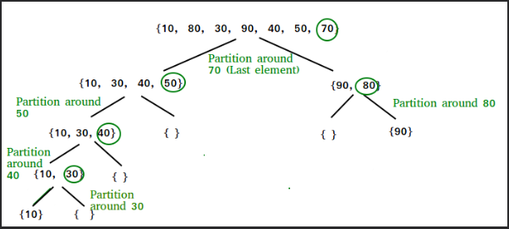
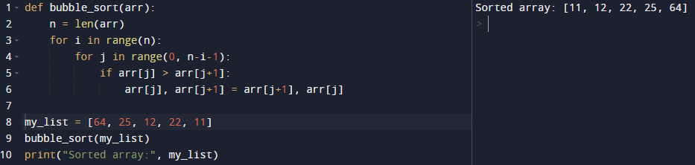
Buble Sort
Coding Section
Quick Sort
Advantages of Quick Sort:
It is a divide-and-conquer algorithm that makes it easier to solve problems.
It is efficient on large data sets.
It has a low overhead, as it only requires a small amount of memory to function.
Disadvantages of Quick Sort:
It has a worst-case time complexity of O(N²), which occurs when the pivot is chosen poorly.
It is not a good choice for small data sets.
It is not a stable sort, meaning that if two elements have the same key, their relative order will not be preserved in the sorted output in case of quick sort, because here we are swapping elements according to the pivot’s position (without considering their original positions).
Advantages of Merge Sort:
Stability: Merge sort is a stable sorting algorithm, which means it maintains the relative order of equal elements in the input array.
Guaranteed worst-case performance: Merge sort has a worst-case time complexity of O(N logN), which means it performs well even on large datasets.
Parallelizable: Merge sort is a naturally parallelizable algorithm, which means it can be easily parallelized to take advantage of multiple processors or threads.
Disadvantages of Merge Sort:
Space complexity: Merge sort requires additional memory to store the merged sub-arrays during the sorting process.
Not in-place: Merge sort is not an in-place sorting algorithm, which means it requires additional memory to store the sorted data. This can be a disadvantage in applications where memory usage is a concern.
Not always optimal for small datasets: For small datasets, Merge sort has a higher time complexity than some other sorting algorithms, such as insertion sort. This can result in slower performance for very small datasets.

Slide 9
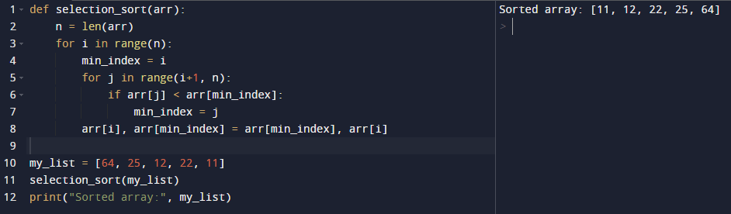
Selection Sort
Coding Section
Advantages of Quick Sort:
It is a divide-and-conquer algorithm that makes it easier to solve problems.
It is efficient on large data sets.
It has a low overhead, as it only requires a small amount of memory to function.
Disadvantages of Quick Sort:
It has a worst-case time complexity of O(N²), which occurs when the pivot is chosen poorly.
It is not a good choice for small data sets.
It is not a stable sort, meaning that if two elements have the same key, their relative order will not be preserved in the sorted output in case of quick sort, because here we are swapping elements according to the pivot’s position (without considering their original positions).
Buble Sort

Slide 10
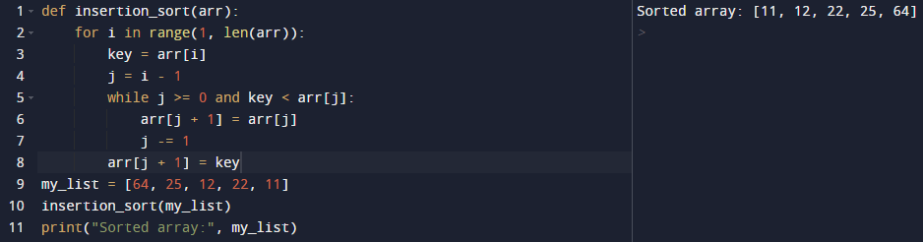
Coding Section
Selection Sort
Insertion Sort

Slide 11
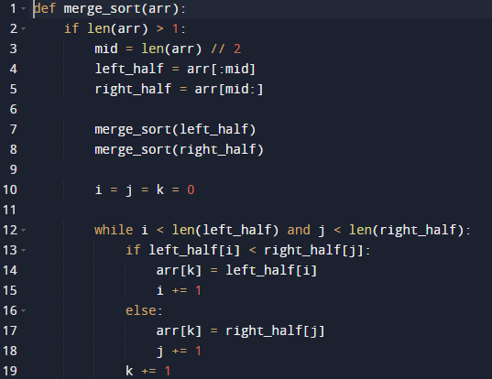

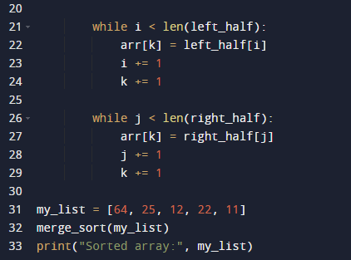
Coding Section
Insertion Sort
Merge Sort

Slide 12
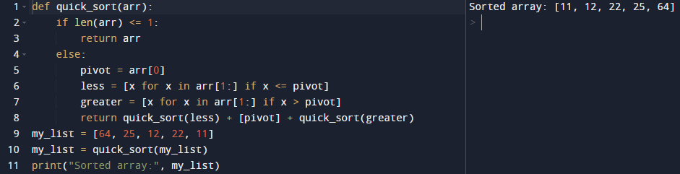
Coding Section
Quick Sort
Merge Sort

Slide 13
Thanks For Watching
Coding Section
Quick Sort
Merge Sort

Slide 14
Coding Section
Thanks For Watching
Quick Sort
Merge Sort

